Slide 1
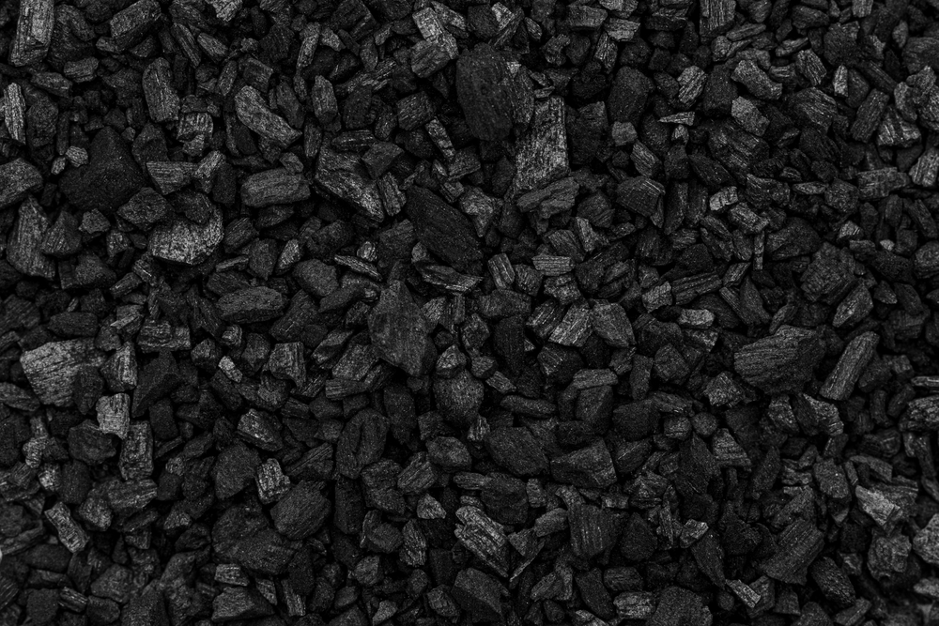

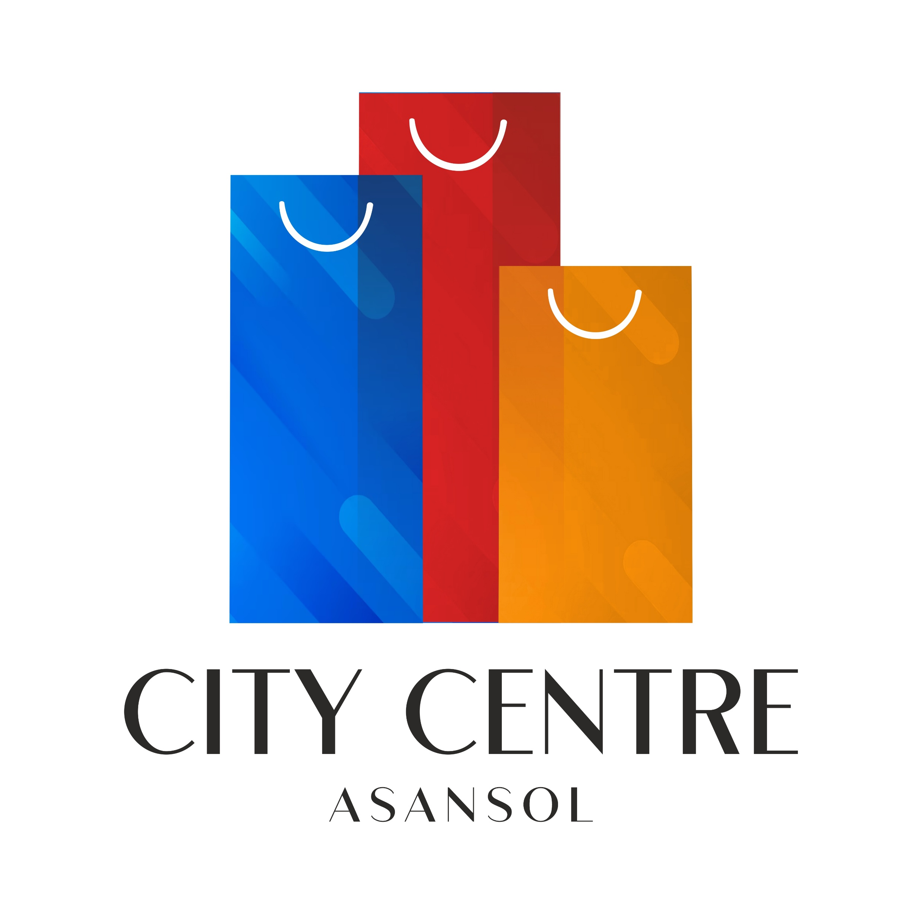
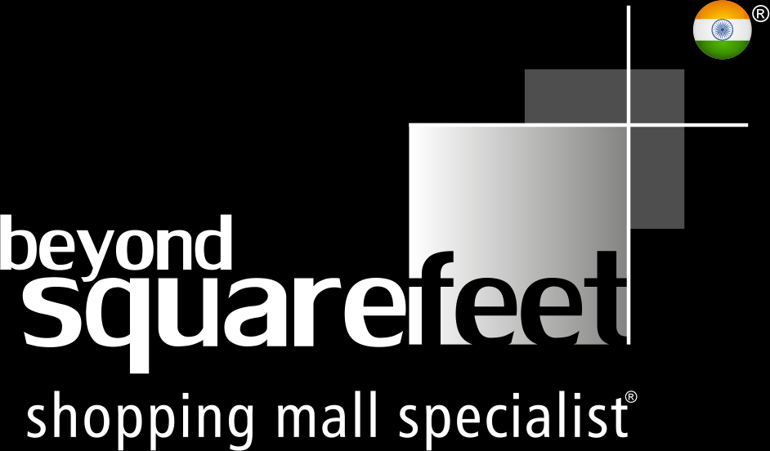
Presenting Asansol’s
ASPIRATIONAL MALL
LEASING DECK
Scheduled
Launch
Oct 2026
Near Railway station, Opp. DRM Office, Munsi Bazar, Asansol, West Bengal – 713301
*Mall logo is subject to change

Slide 2
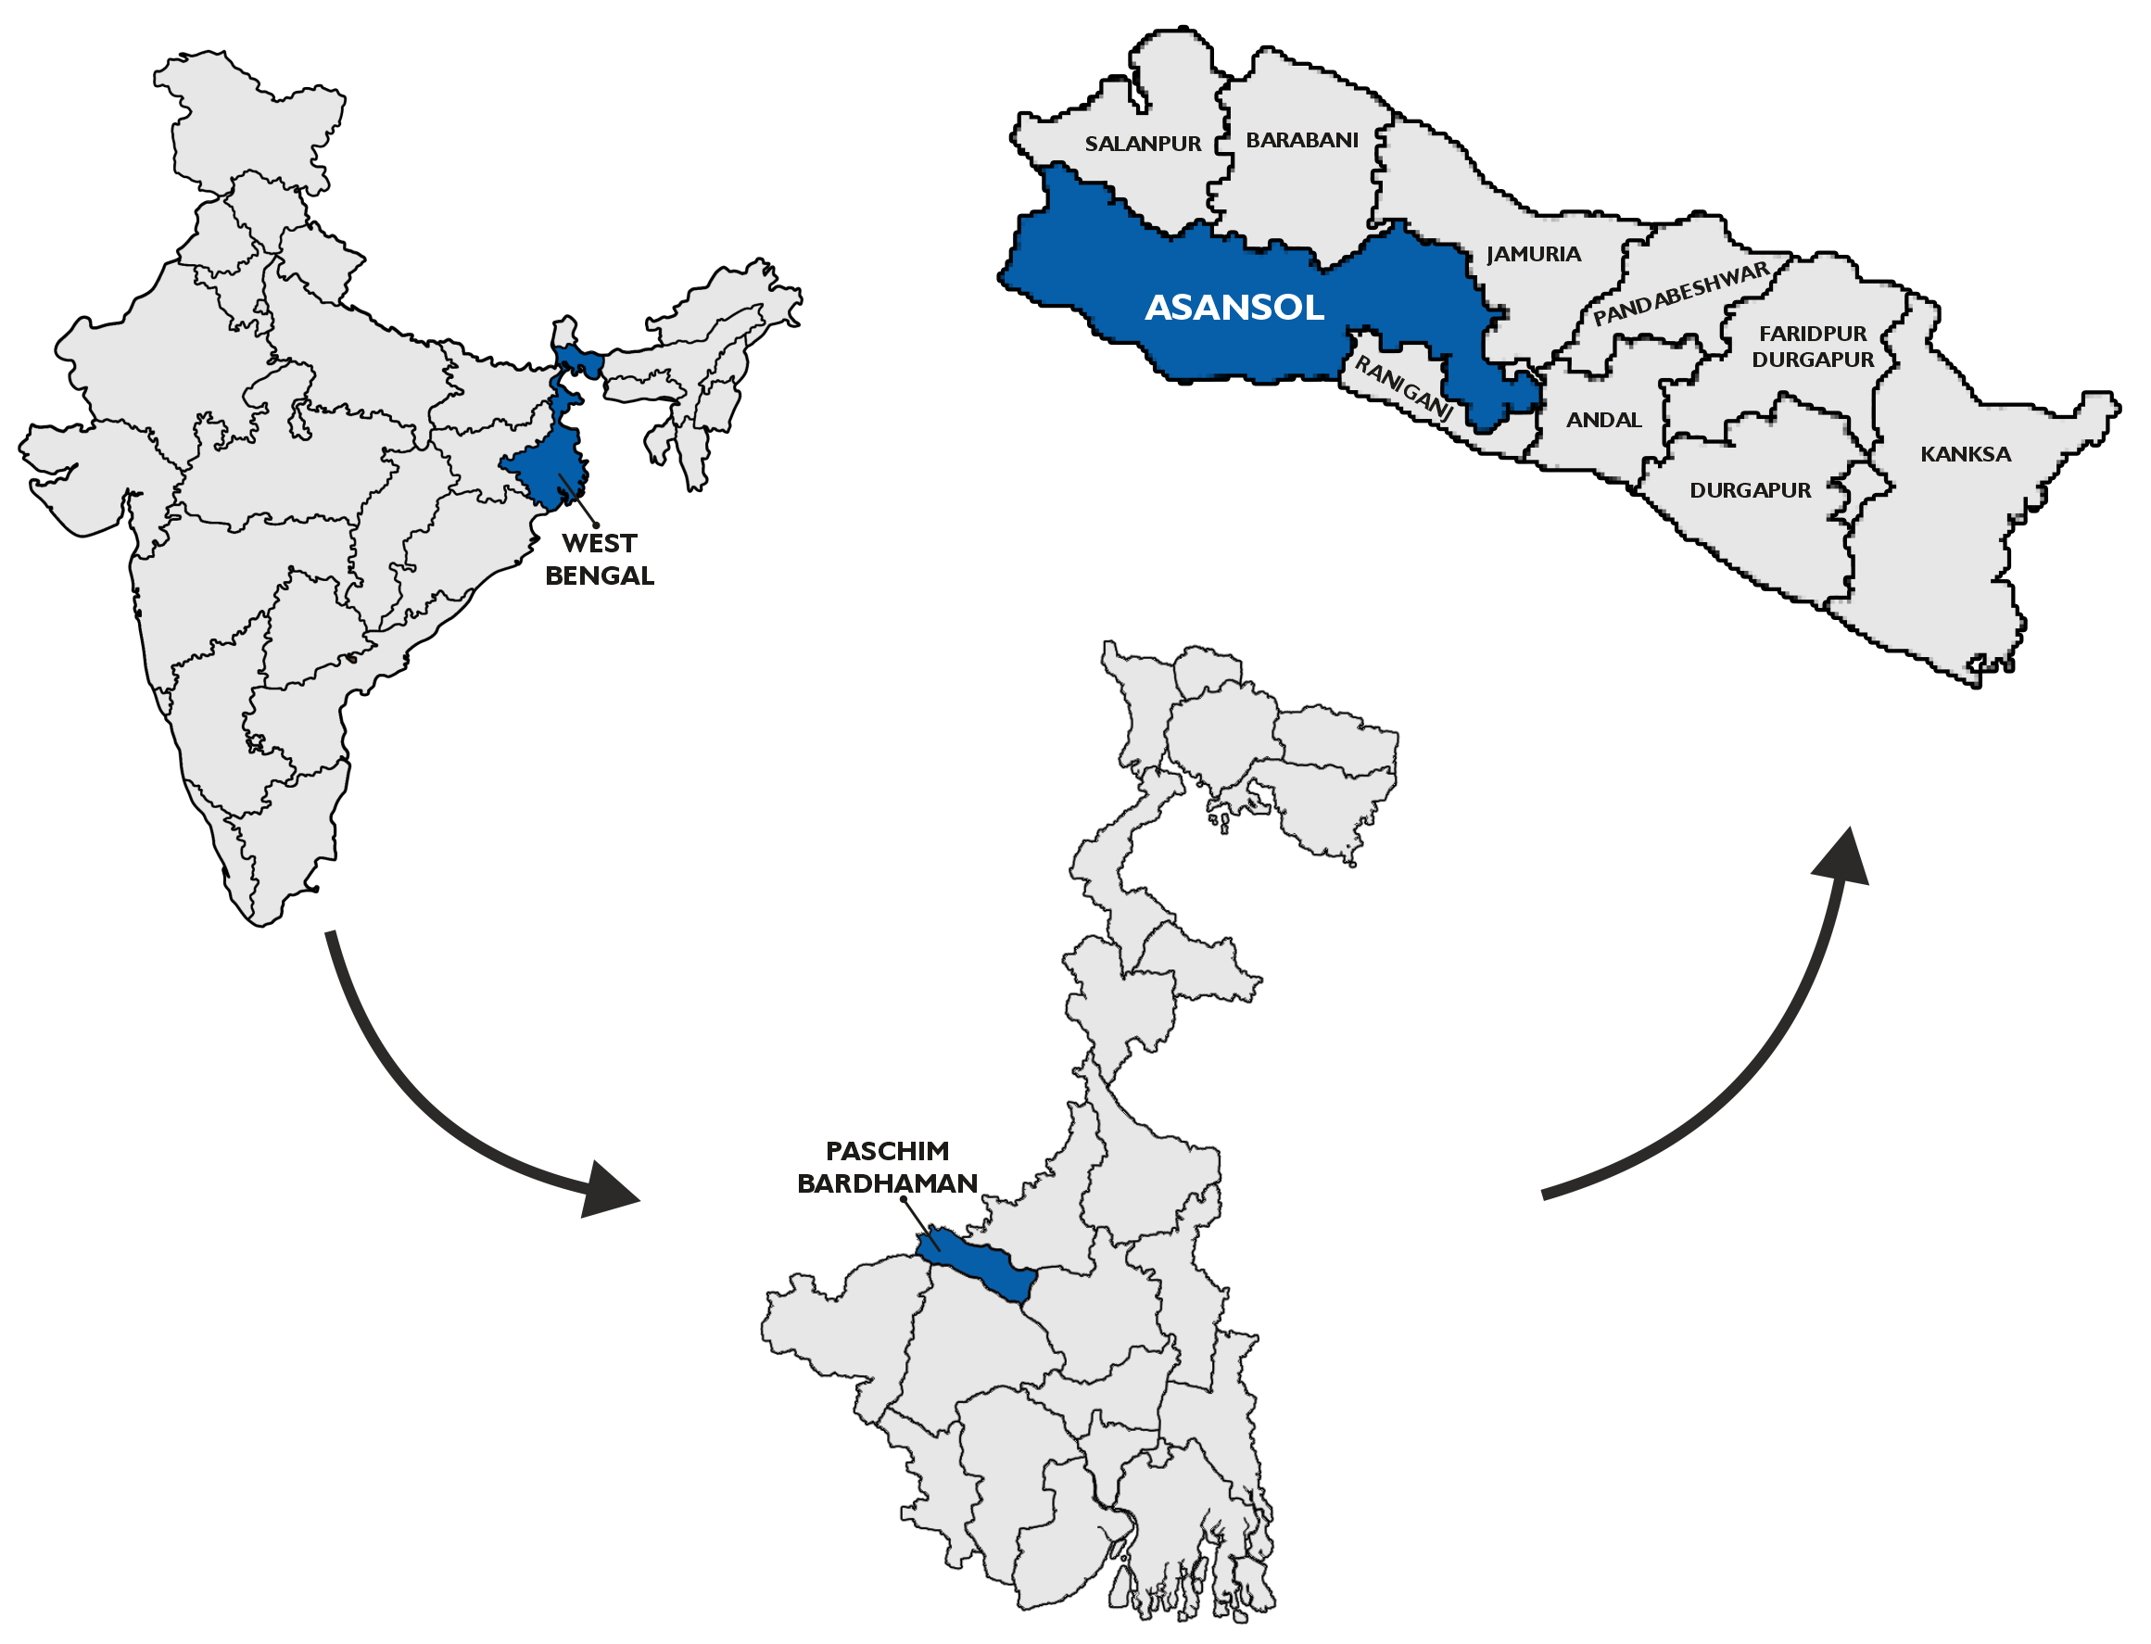
Where is Asansol?

Slide 3

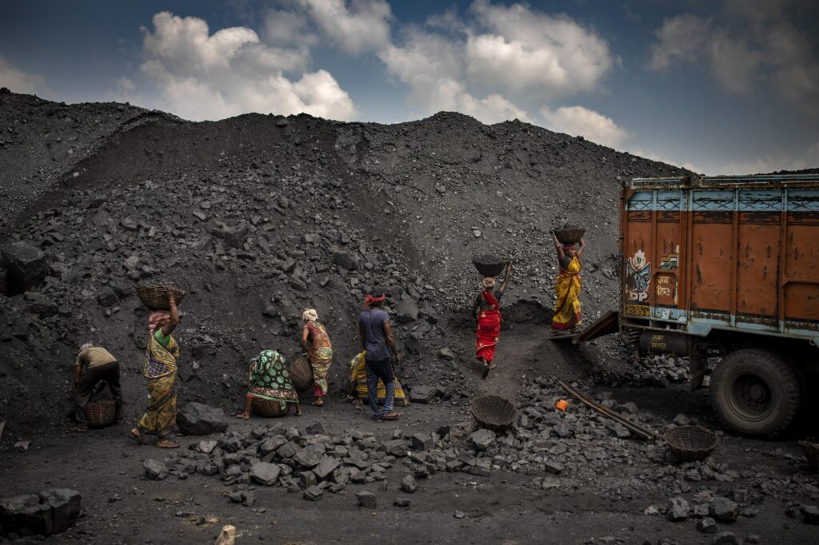
Asansol is famously known as….
The City of Brotherhood
The City of Black Diamonds
This title reflects the city's exceptional cultural diversity and the harmonious coexistence of people from various religious and cultural backgrounds.
Black Diamond is a synonym of Coal. Asansol is one of the largest producers of coal in India and the second largest city in West Bengal known for its thriving coal business.

Slide 4
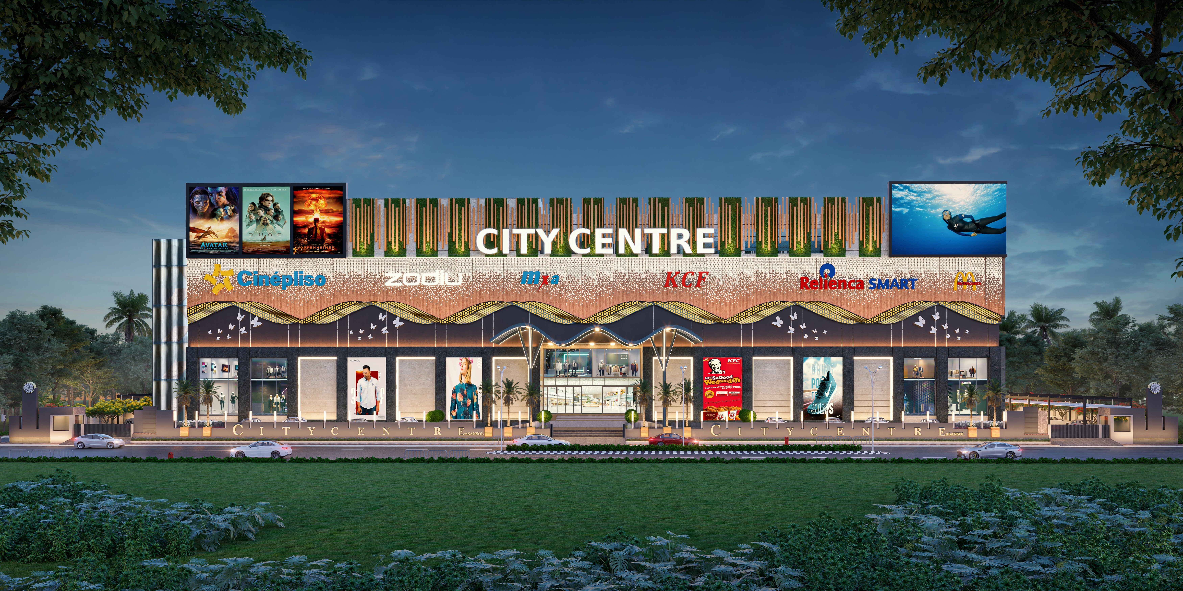
Proposed Façade
*Mall Façade is subject to change

Slide 5
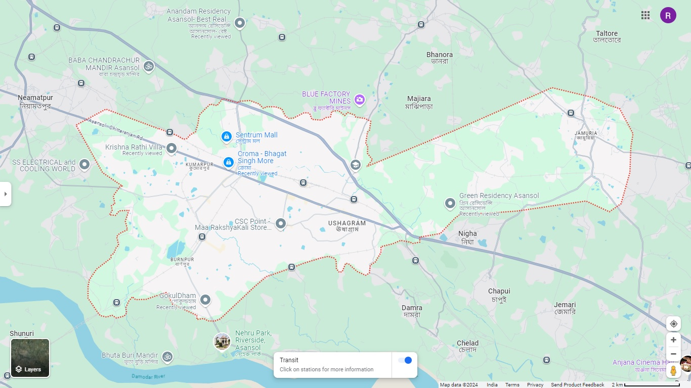



Location Map
ASANSOL CITY LIMITS
NH19
BUS DEPOT
RAILWAY STATION
CITY CENTER
ASANSOL CITY LIMITS
NH19

Slide 6
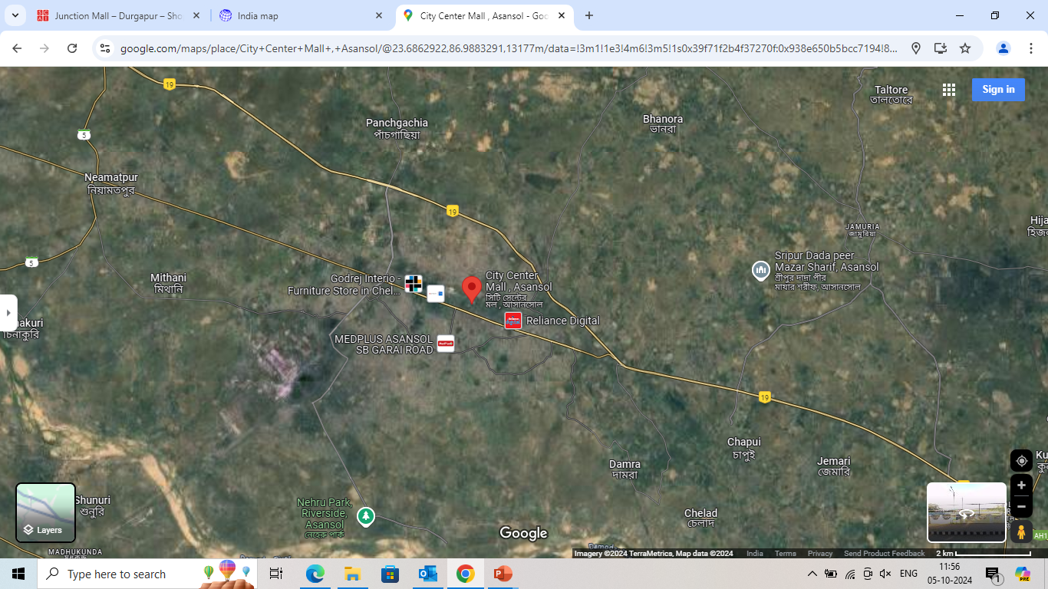
Primary Catchment – 5km Radius
PANCHGACHIA
MONOHAR BAHAL B
KALYANPUR
KANYAPUR
MAJIARA
RAILPAR
DHADKA
PARIHARPUR
KUMARPUR
RABINDRA NAGAR
KANKHAYA
CITY CENTER
CHELIDANGA
USHAGRAM
HAMID NAGAR
MOHISHILA COLONY

Slide 7





Mall Snapshot
1
2
3
4
5
2,00,000 sq. ft.
BUA
3 Screen Multiplex (425 Seats)
50+ Vanilla Brands
10+
Food Counters
200+ Vehicle Parking

Slide 8
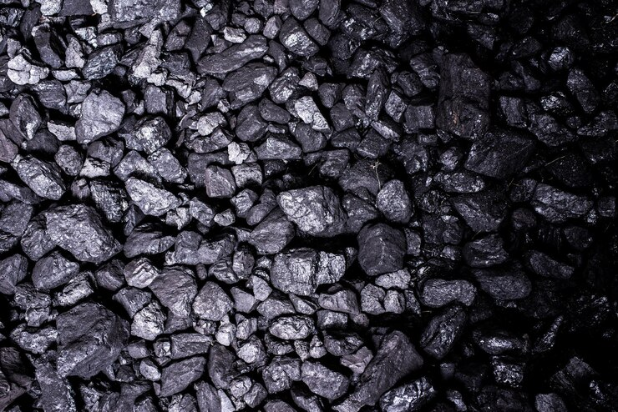
Floor Plans

Slide 9
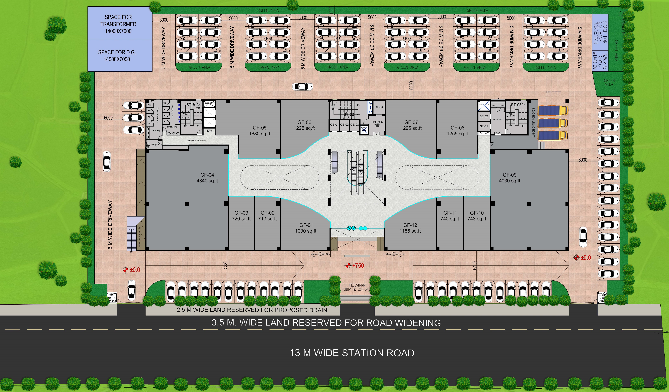
Site Plan

Slide 10
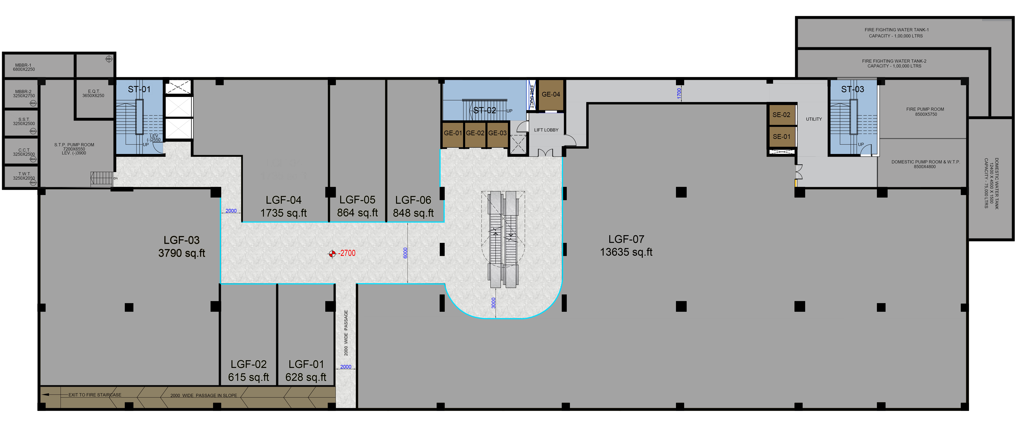
Lower Ground Floor
Mumuso
VIVO
OPPO
Reliance Smart
R&B
VIP Lounge
Samsonite
Brand Names | Proposed to brands
Brand Logos | Signed

Slide 11
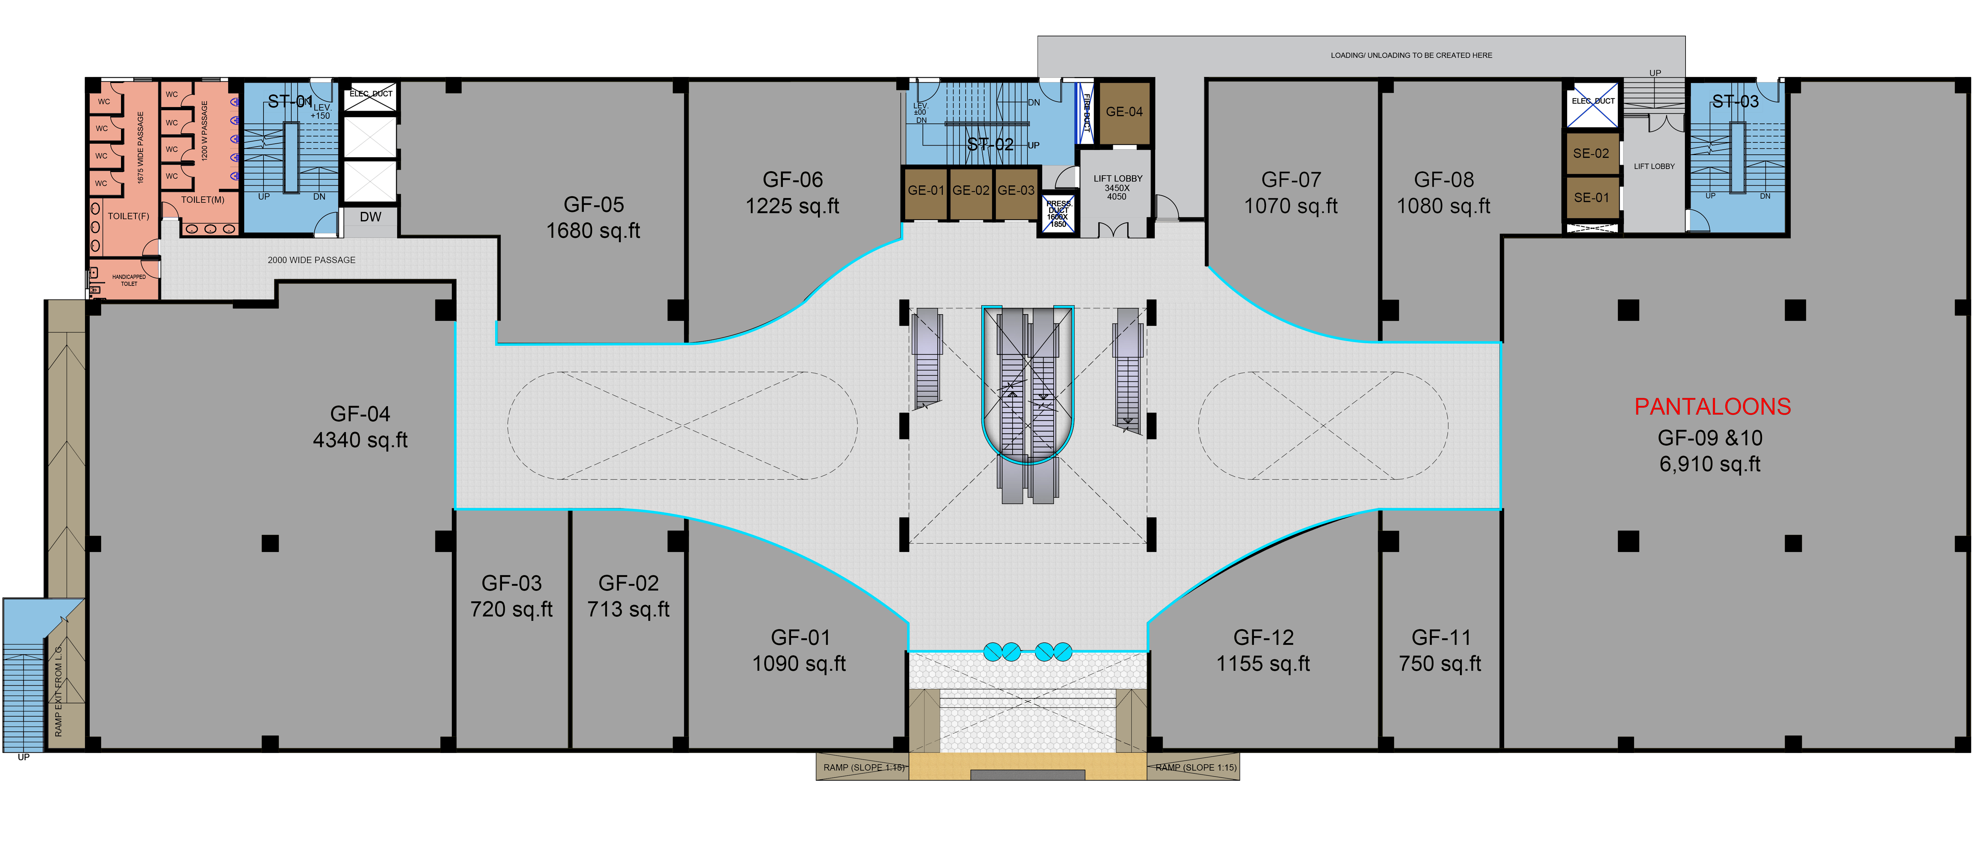

Ground Floor
Skechers
Addidas
PUMA
Woodland
Azorte/ Reliance Trends
R&B
GKB
Crocs
Levi’s
Nykaa
Samsung
Brand Names | Proposed to brands
Brand Logos | Signed

Slide 12
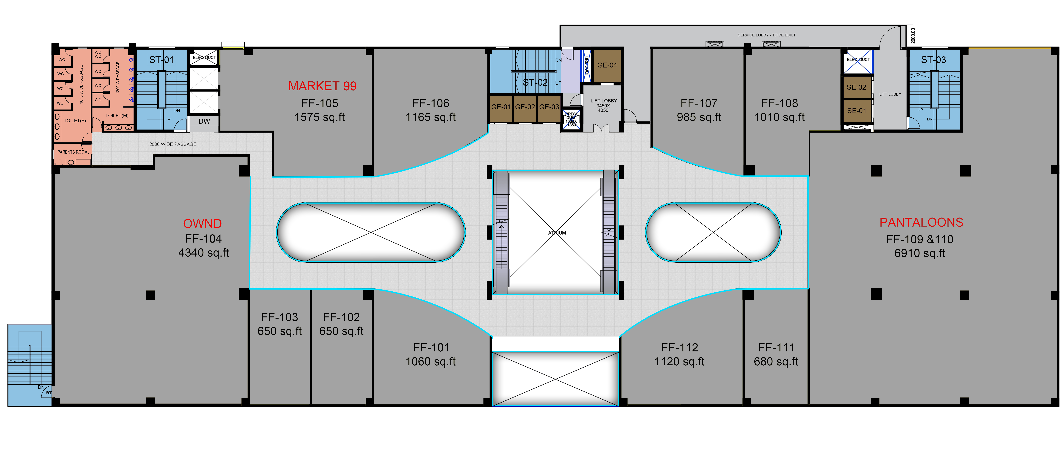


First Floor
Mochi
Manyavar
Blackberrys
Wildcraft
Himalaya
Optical
Raymond’s
Octave
Mufti
Brand Names | Proposed to brands
Brand Logos | Signed

Slide 13
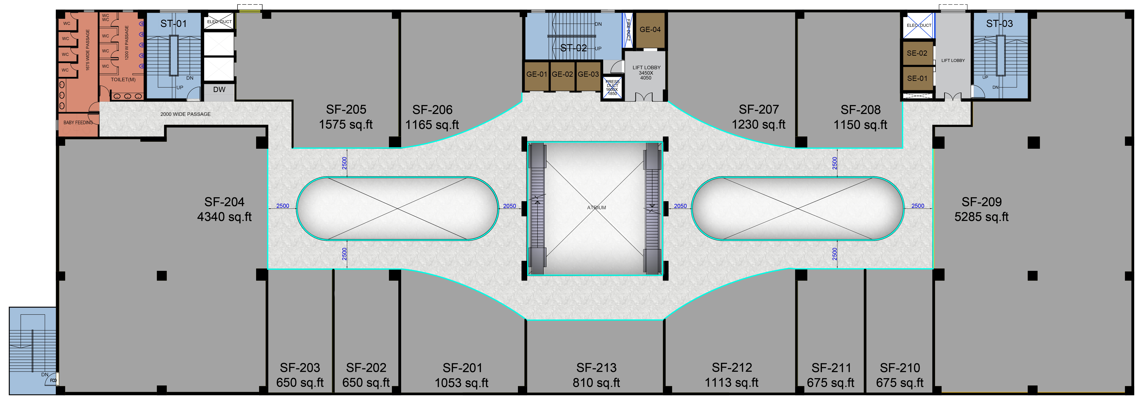
Second Floor
W/Aurelia
Biba/ Rangriti
Regional Brand
Regional Brand
Indo Era
Gini & Jony
Go Colors
Trends Woman
Trends Junior
Brand Names | Proposed to brands
Brand Logos | Signed

Slide 14
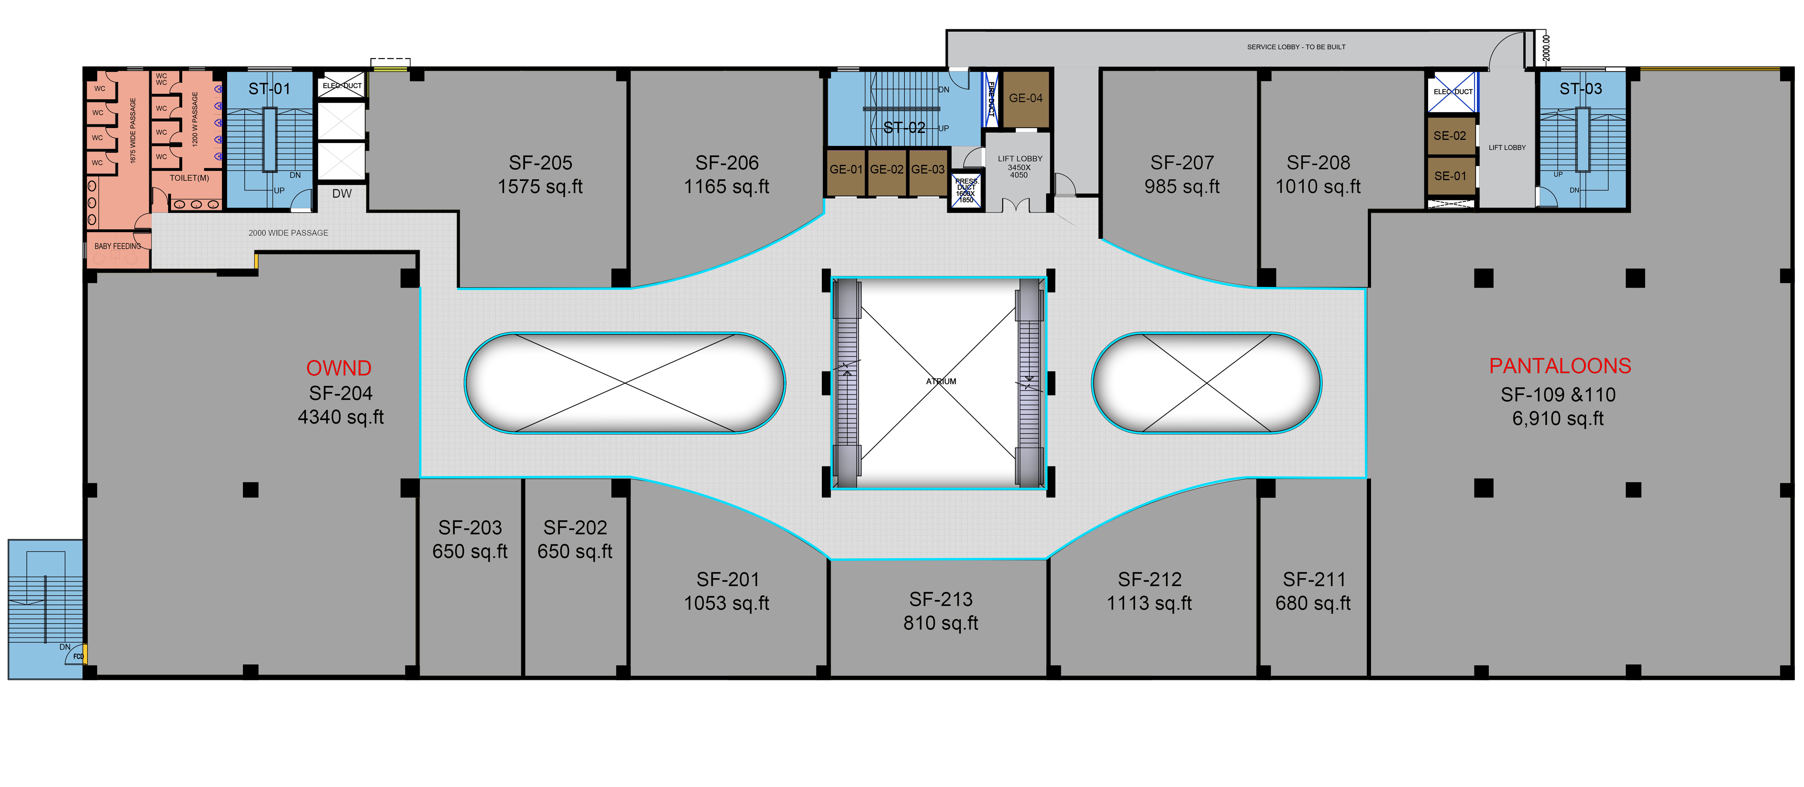
Second Floor
Regional Brand
Regional Brand
W/Aurelia
Biba/ Rangriti
Indo Era
Go Colors
Gini & Jony
Trends Woman
Trends Junior
Brand Names | Proposed to brands
Brand Logos | Signed

Slide 15
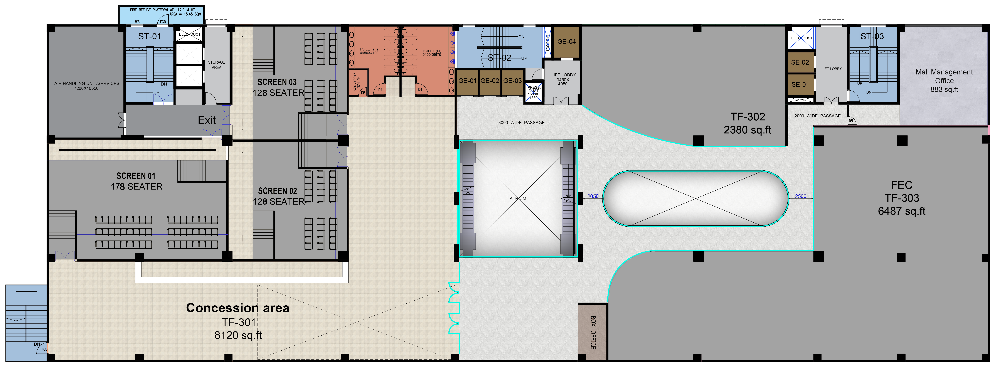

Third Floor
Mainland China
Amoeba
Brand Names | Proposed to brands
Brand Logos | Signed

Slide 16
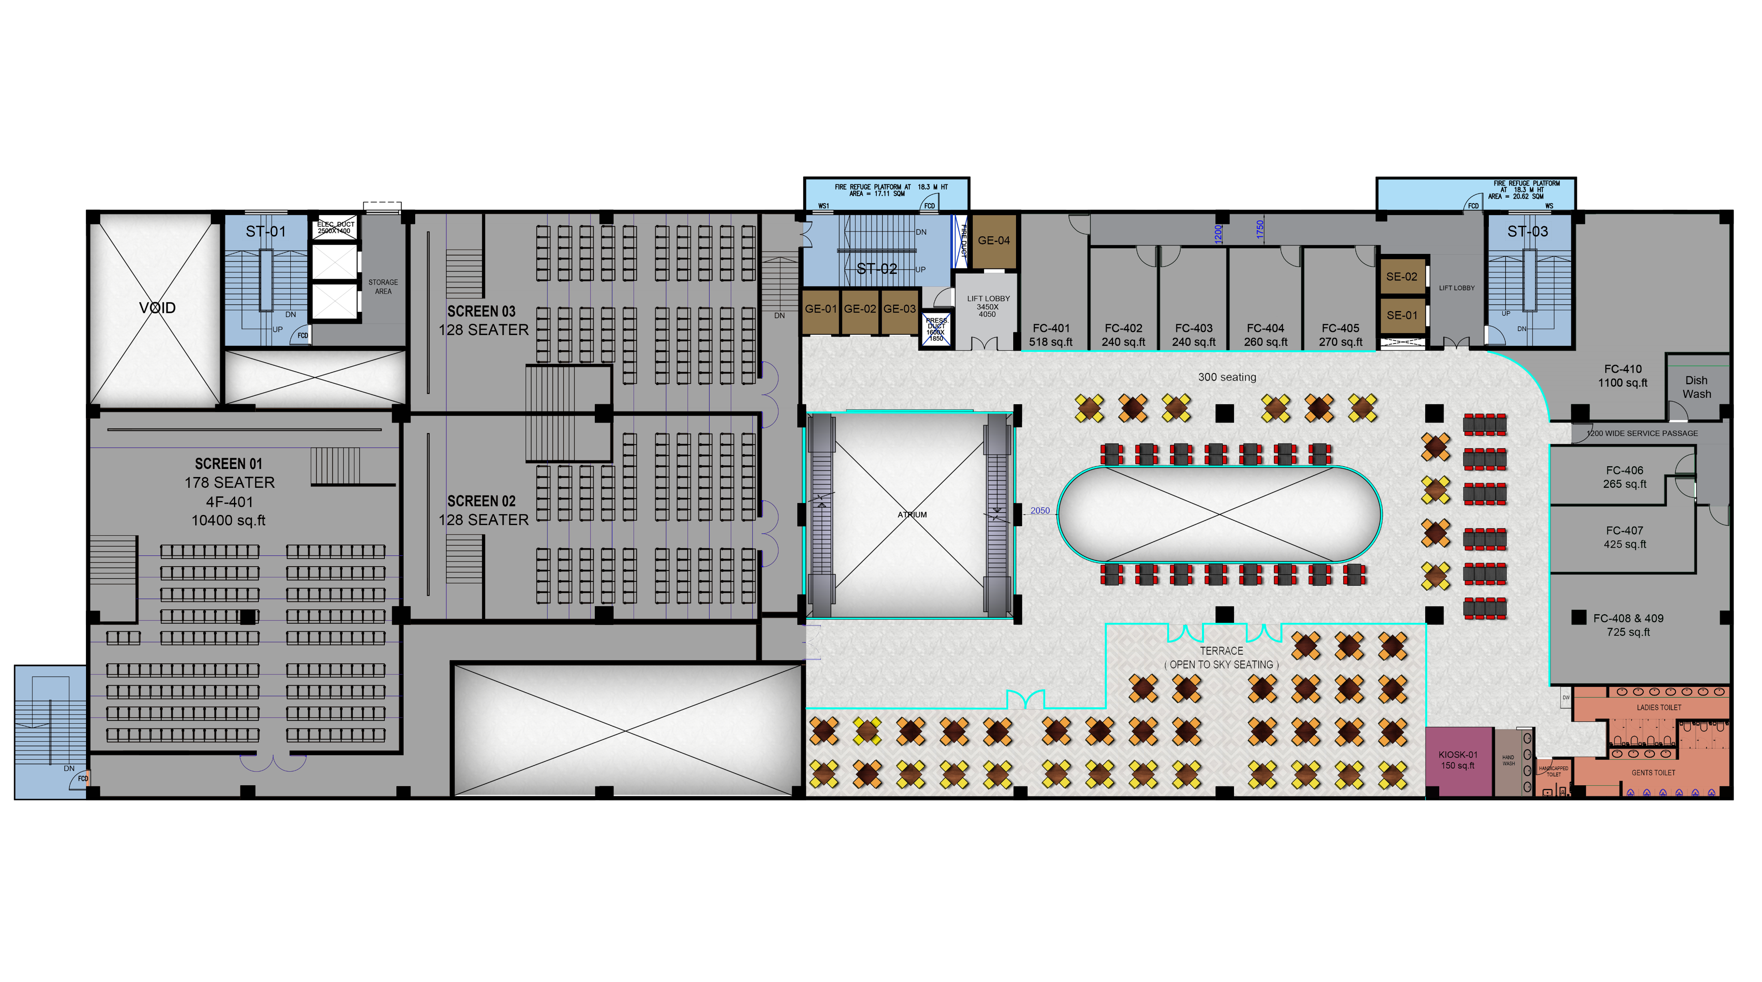
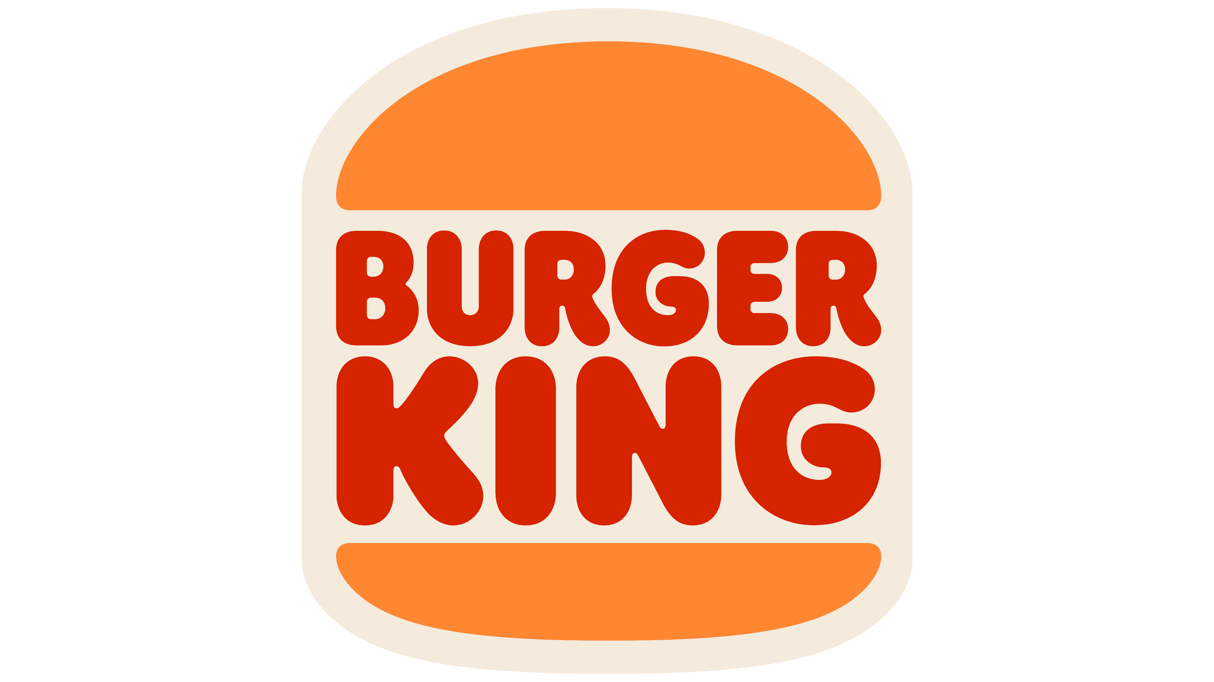



Fourth Floor
Subway
Kailash Parbat
SF by PG
Asia 7
Brand Names | Proposed to brands
Brand Logos | Signed

Slide 17
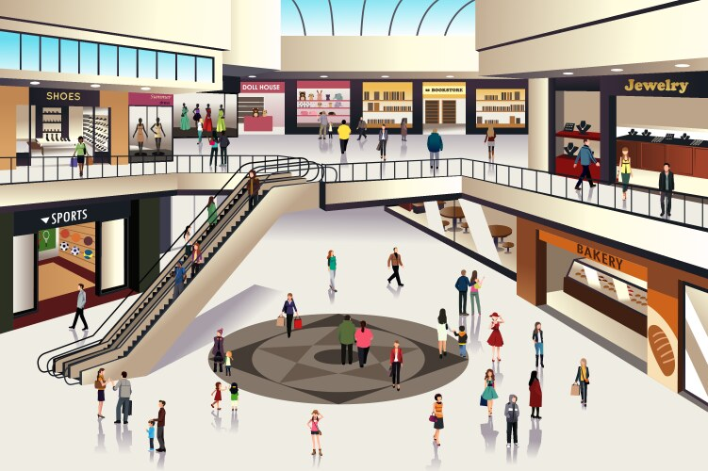
Detail for Retail
Prime Location – Heart of the city.
Only 100% Leased Mall in the City.
A huge population of 17,00,000+ to cater to.
Second largest city of West Bengal.
Railway station & Bus stand within 1 km of the Mall.
Dedicated parking for 200 cars.
Economy driven by Steel & Coal, Railways, Trade & Commerce.
Fitouts by June - 26.

Slide 18
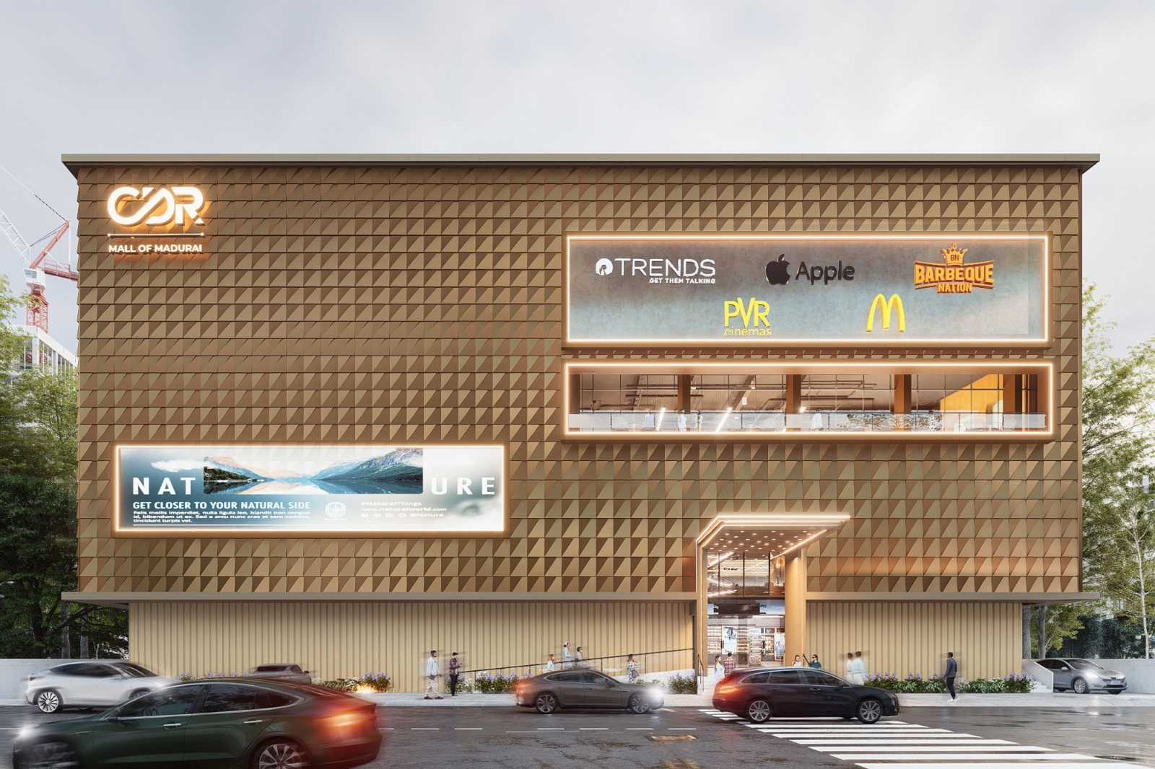
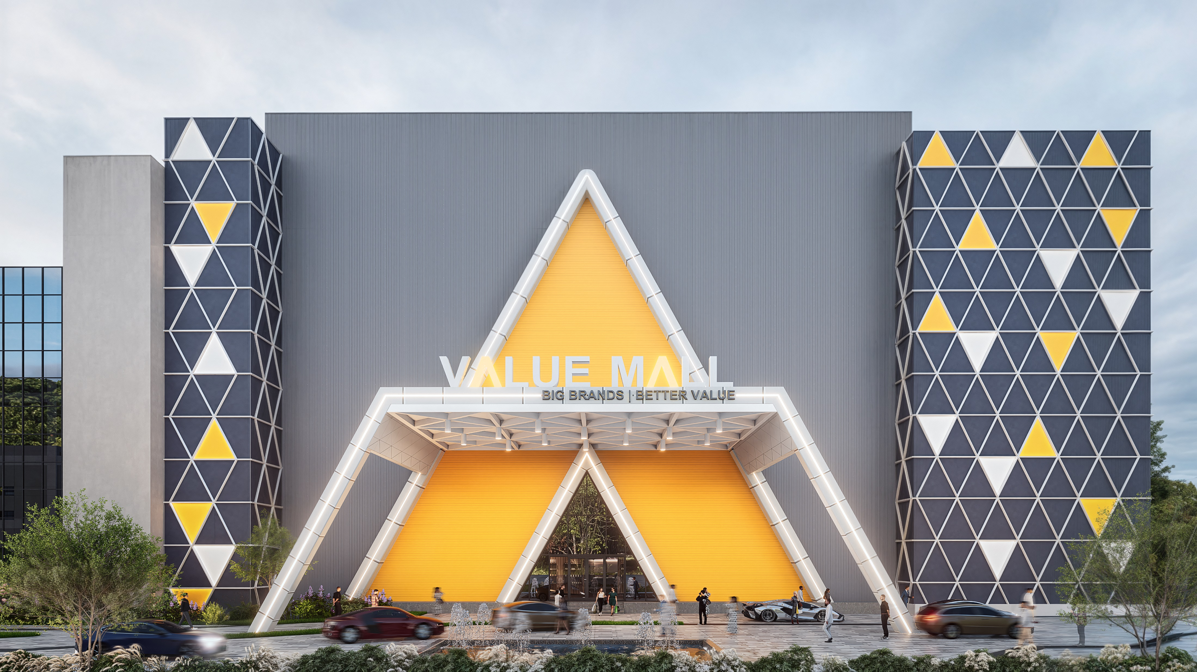
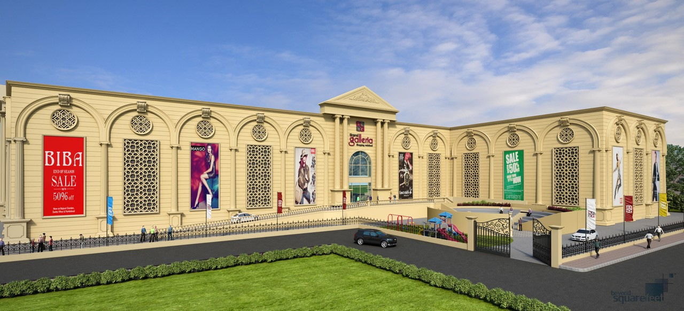
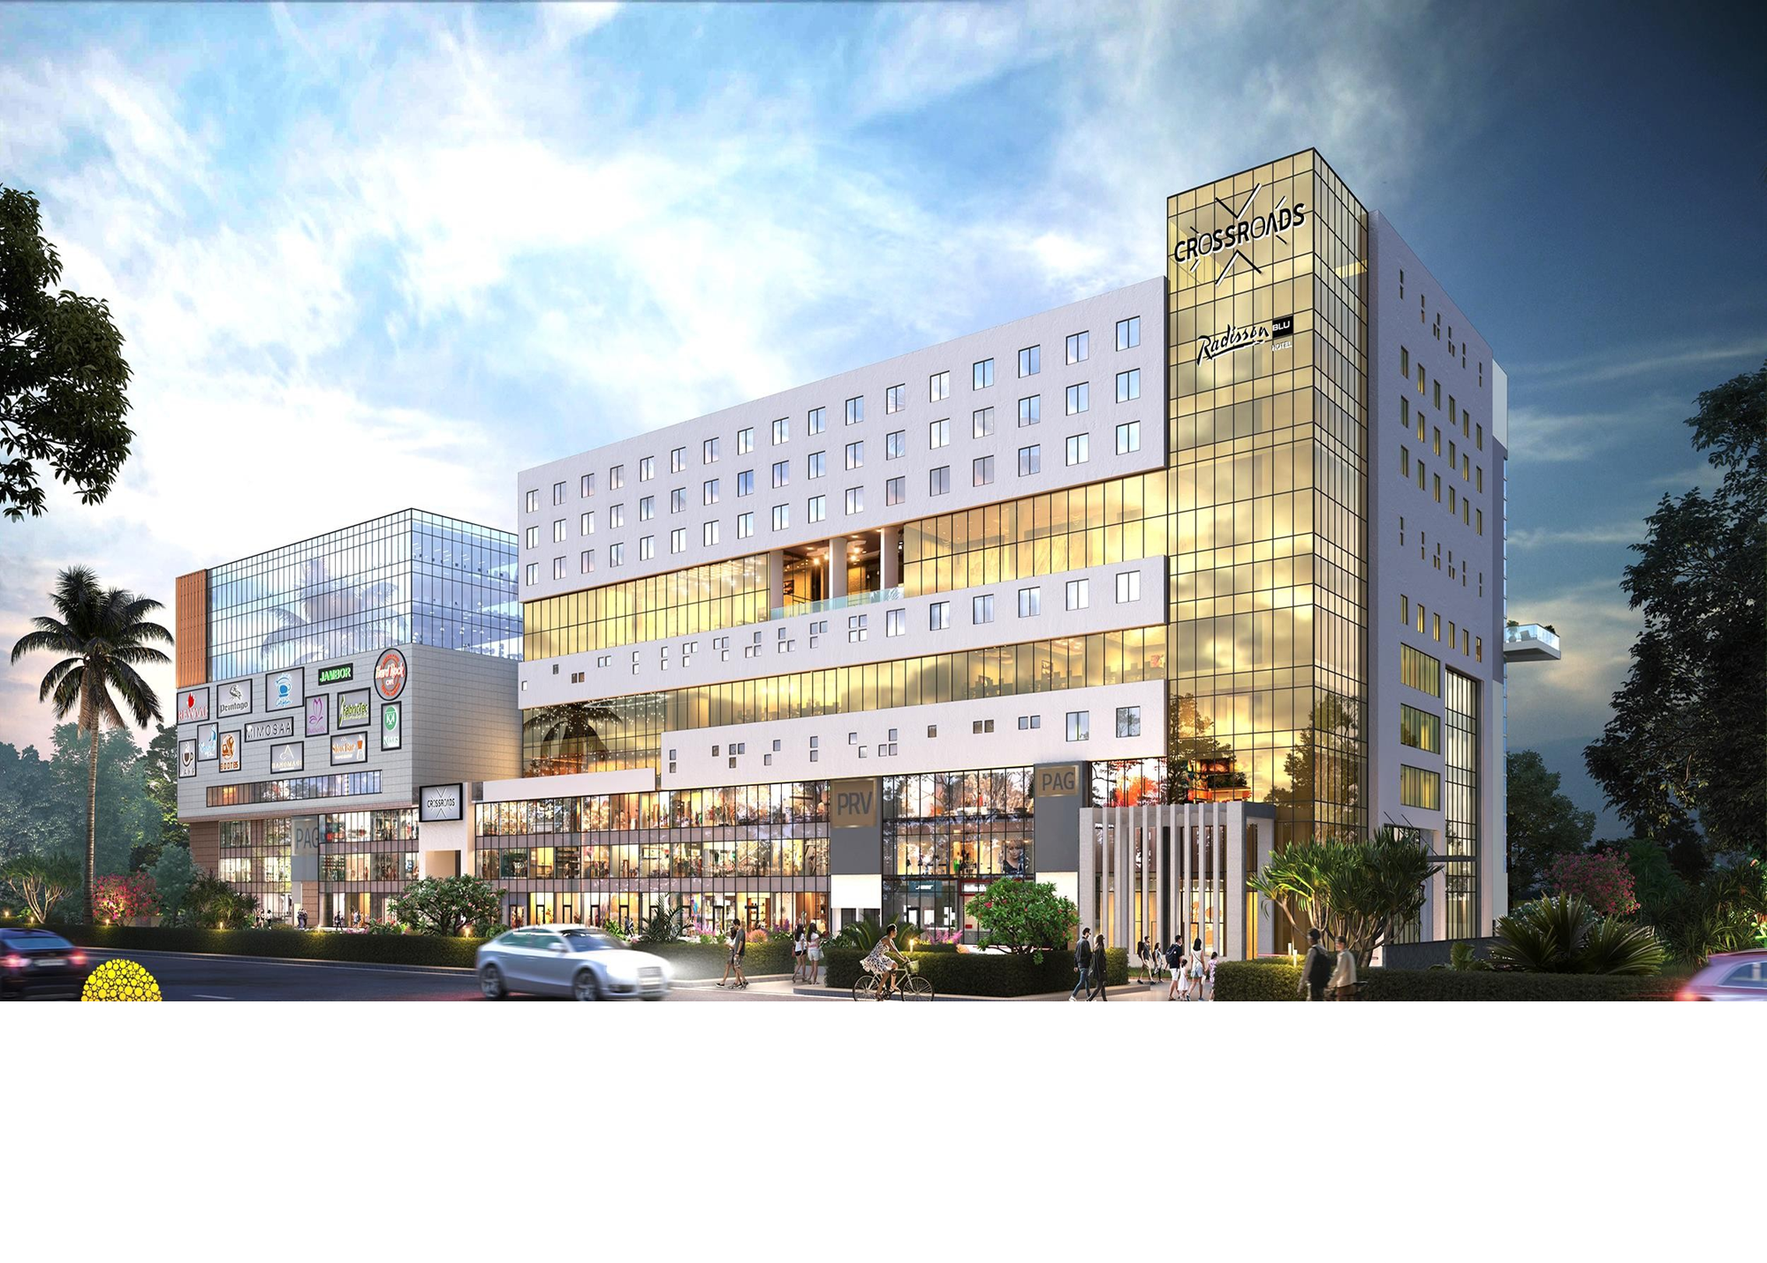
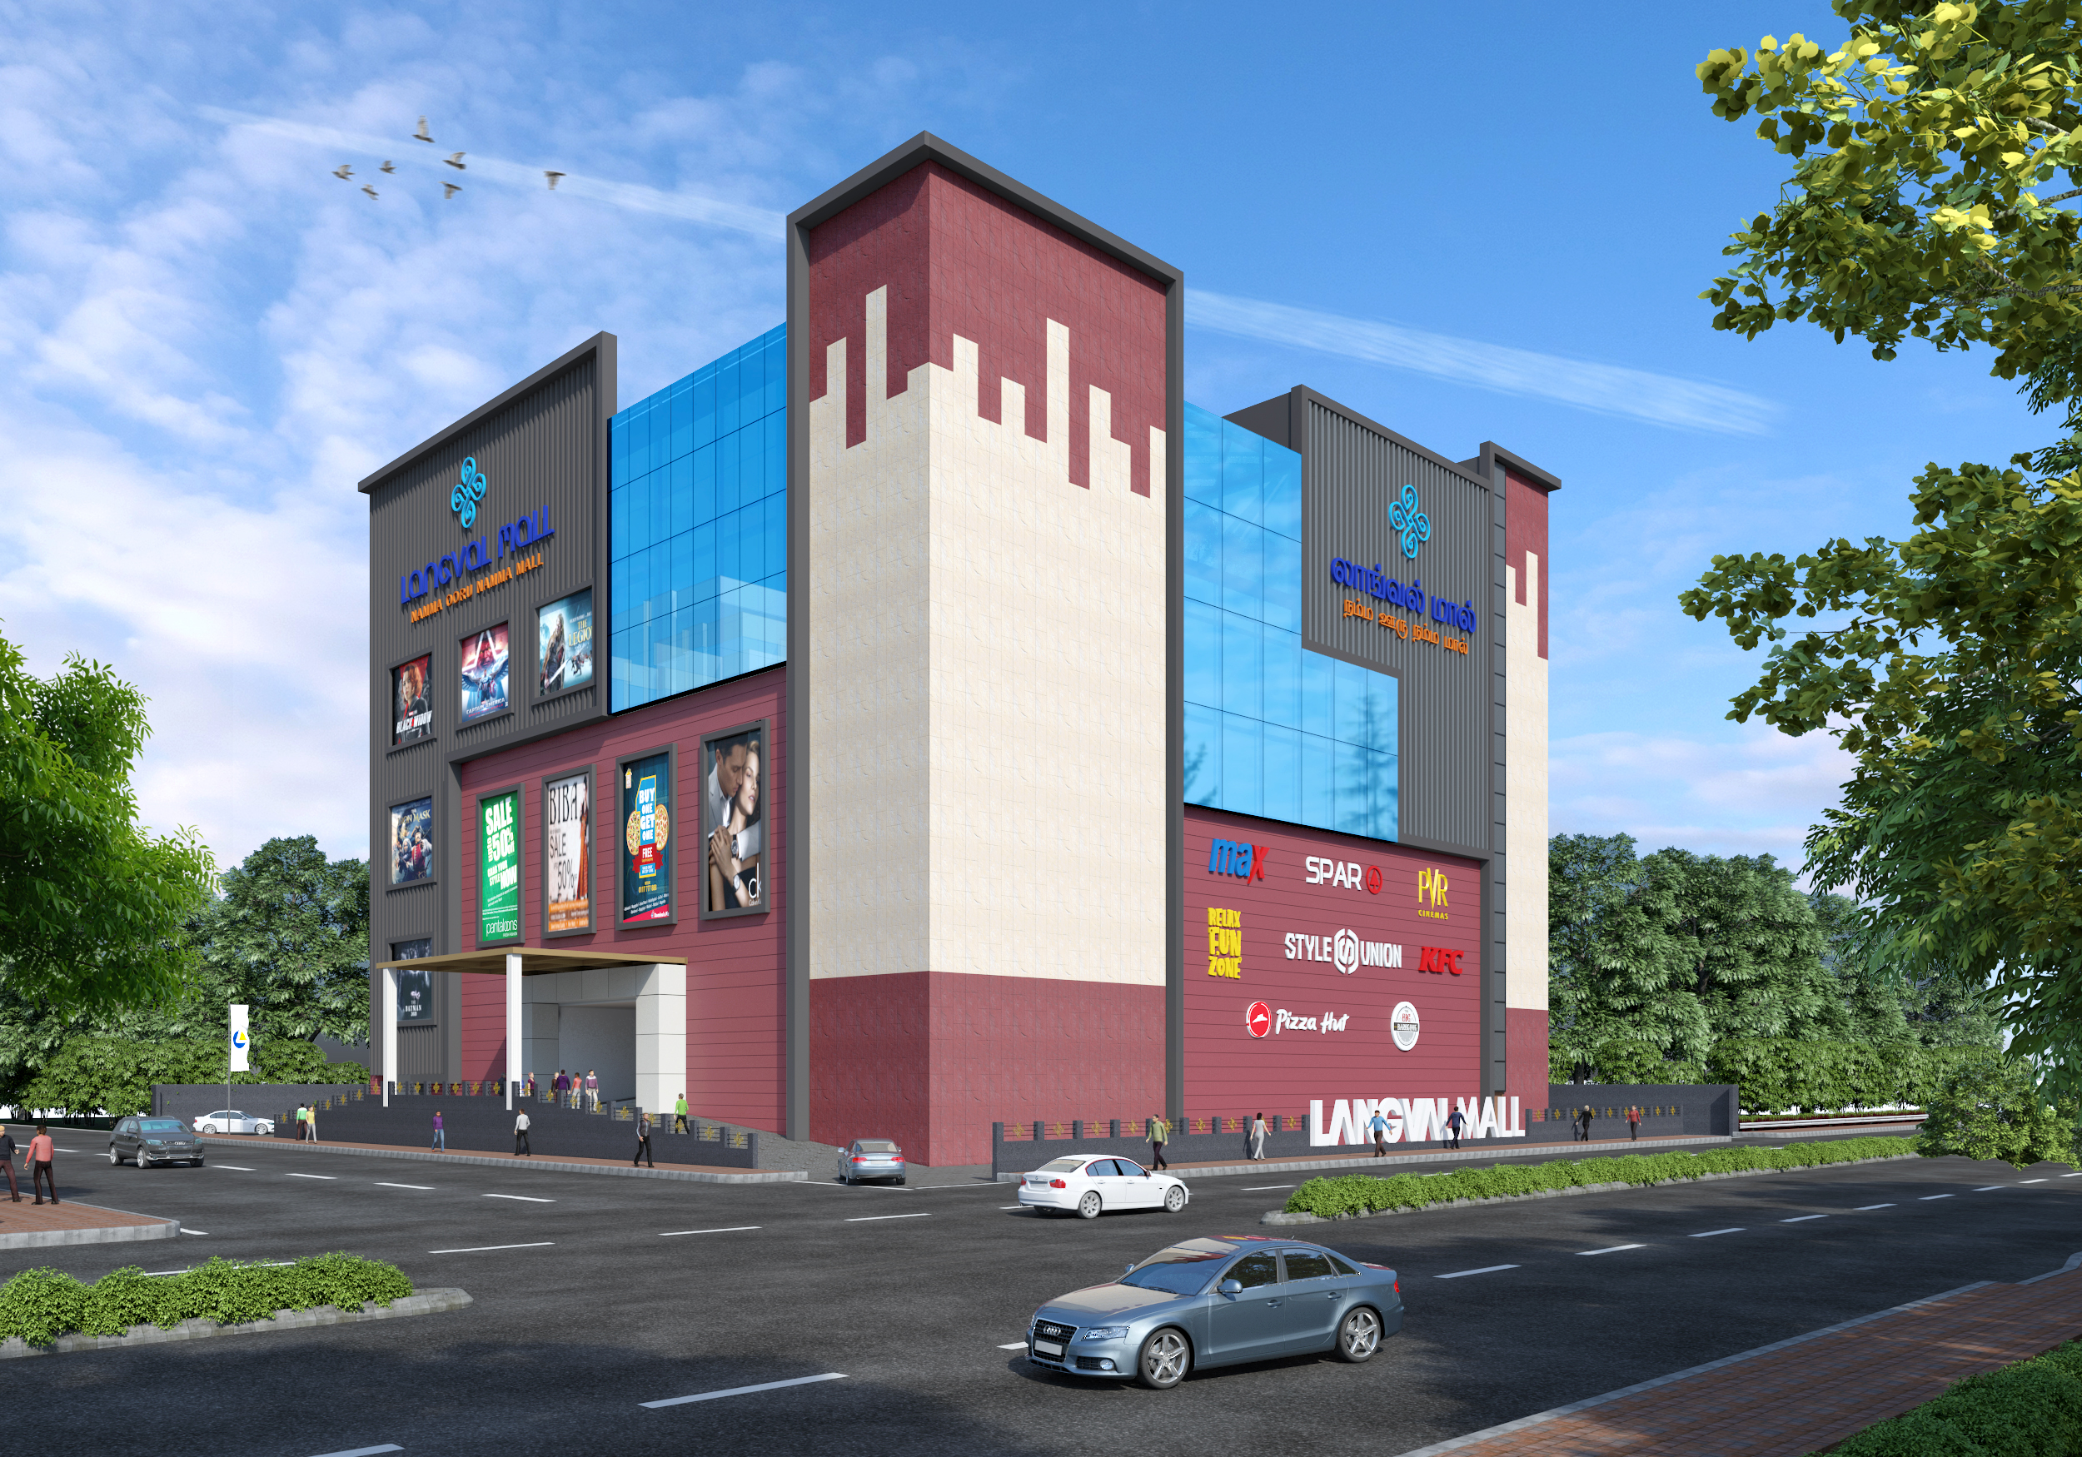
Concurrently Leasing
CDR Mall (Madurai)
Value Mall (Erode)
Grand Galleria (Purnia)
Crossroads Mall (Siliguri)
Langval Mall (Thanjavur)

Slide 19
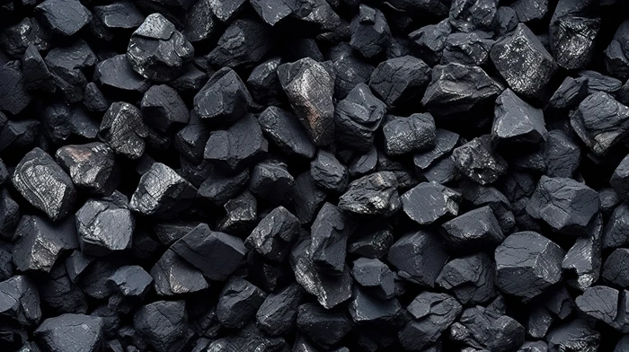
EXCLUSIVELY CONCEPTUALIZED, MARKETED & LEASED BY
Leaseline +91- 90041 41256
leasing@beyondsquarefeet.com

